Slide 1
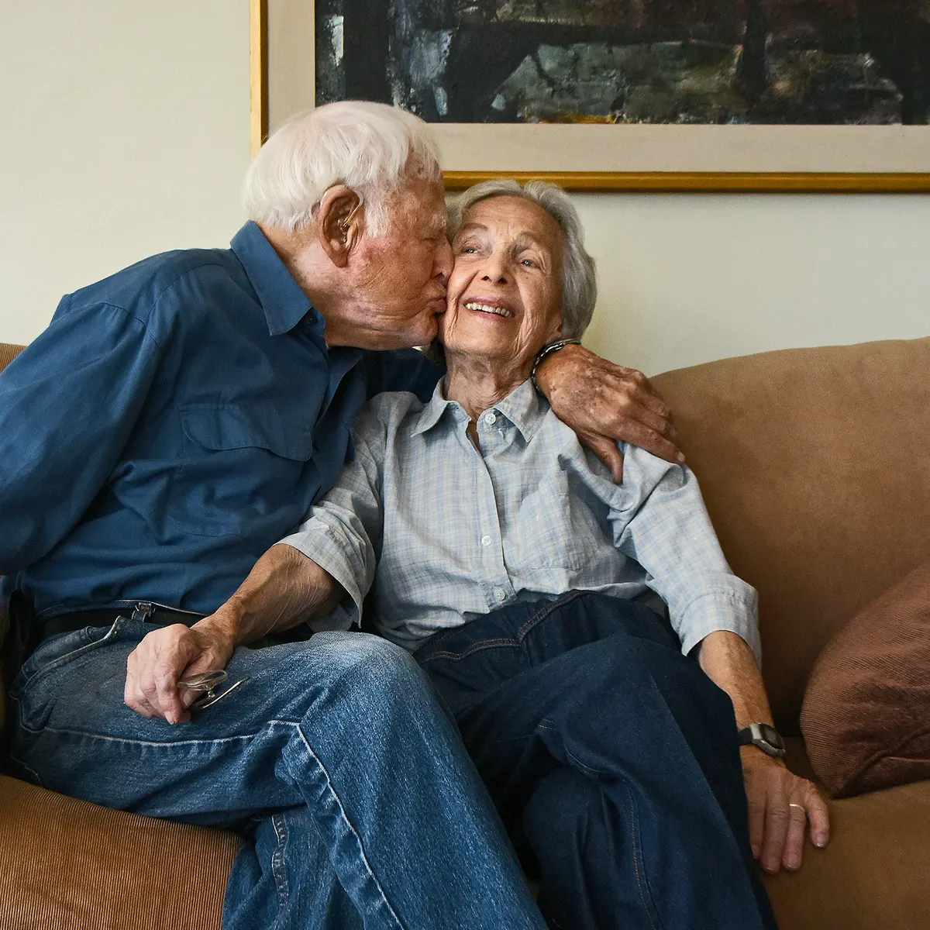

Grow old with you
by dodong junjun

Slide 2
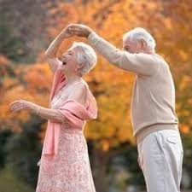
I wanna make you smile whenever you're sad

Slide 3
Carry you around when your arthritis is bad

Slide 4
All I wanna do is grow old with you

Slide 5
I'll get your medicine when your tummy aches

Slide 6
Build you a fire if the furnace breaks

Slide 7
It could be so nice, growing old with you

Slide 8
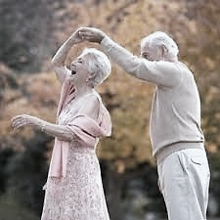
I'll miss you
Kiss you

Slide 9
Give you my coat when you are cold

Slide 10
Need you
Feed you

Slide 11
Even let you hold the remote control

Slide 12
So let me do the dishes in our kitchen sink

Slide 13
Put you to bed when you've had too much to drink

Slide 14
I could be the man who grows old with you

Slide 15
Who grows old with you....

Slide 16
Thank you for Watching !

Slide 17
Group kokoro
Earl James Yonson
Harvey Perater
Jenel Eric Fernandez

